Slide 2
In the beginning, there was symmetric encryption.

Slide 3
If you had the key you could encrypt …

Slide 4
If you had the key you could encrypt …
Message:
Key: +3
Ciphertext:
ATTACK AT DAWN
↓↓↓↓↓↓ ↓↓ ↓↓↓↓
DWWDFN DW GDZQ

Slide 5
If you had the key you could decrypt …

Slide 6
If you had the key you could decrypt …
Message:
Key: +3
Ciphertext:
ATTACK AT DAWN
↑↑↑↑↑↑ ↑↑ ↑↑↑↑
DWWDFN DW GDZQ

Slide 7
… and some people were happy.

Slide 8
Then, there was asymmetric encryption.

Slide 9
Some people encrypted …

Slide 10
Some people encrypted …
… others decrypted.

Slide 11
E-commerce ensued …

Slide 12
E-commerce ensued …
… and more people were happy.

Slide 13
The first and most used asymmetric cipher was RSA.

Slide 14
The first and most used asymmetric cipher was RSA.
$$E\left(m\right)=m^{e} (\operatorname{mod}{n)}$$

Slide 15
Some people noticed the algebraic structure …

Slide 16
Some people noticed the algebraic structure …
$$E\left(m_{1}\right)= {m_{1}}^{e} E\left(m_{2}\right)= {m_{2}}^{e}$$

Slide 17
Some people noticed the algebraic structure …
$$E\left(m_{1}\right)= {m_{1}}^{e} E\left(m_{2}\right)= {m_{2}}^{e}$$
Ergo …

Slide 18
Some people noticed the algebraic structure …
$$E\left(m_{1}\right)= {m_{1}}^{e} E\left(m_{2}\right)= {m_{2}}^{e}$$
Ergo …
$E\left(m_{1}\right)×E\left(m_{2}\right)$

Slide 19
Some people noticed the algebraic structure …
$$E\left(m_{1}\right)= {m_{1}}^{e} E\left(m_{2}\right)= {m_{2}}^{e}$$
Ergo …
$E\left(m_{1}\right)×E\left(m_{2}\right)$
$={m_{1}}^{e}×{m_{2}}^{e}$

Slide 20
Some people noticed the algebraic structure …
$$E\left(m_{1}\right)= {m_{1}}^{e} E\left(m_{2}\right)= {m_{2}}^{e}$$
Ergo …
$E\left(m_{1}\right)×E\left(m_{2}\right)$
$={m_{1}}^{e}×{m_{2}}^{e}$
$={(m_{1}×m_{2})}^{e}$

Slide 21
Some people noticed the algebraic structure …
$$E\left(m_{1}\right)= {m_{1}}^{e} E\left(m_{2}\right)= {m_{2}}^{e}$$
Ergo …
$E\left(m_{1}\right)×E\left(m_{2}\right)$
$={m_{1}}^{e}×{m_{2}}^{e}$
$={(m_{1}×m_{2})}^{e}$
$=E(m_{1}×m_{2})$

Slide 22
They looked for interesting applications …

Slide 23
They looked for interesting applications …
… and they failed.

Slide 24
People mused …

Slide 25
People mused …
… if only RSA worked additively …

Slide 26
People mused …
… if only RSA worked additively …
we could compute sums …

Slide 27
People mused …
… if only RSA worked additively …
we could compute sums …
and averages …

Slide 28
People mused …
… if only RSA worked additively …
we could compute sums …
and averages …
and tally elections …

Slide 29
I was one of those musing.

Slide 30
I was one of those musing.
An additive encryption homomorphism …

Slide 31
I was one of those musing.
An additive encryption homomorphism …
$$E\left(m,r\right)=r^{e}c^{m}$$

Slide 32
$$E\left(m_{1},r_{1}\right)= {r_{1}}^{e}c^{m_{1}} E\left(m_{2},r_{2}\right)= {r_{2}}^{e}c^{m_{2}}$$

Slide 33
$$E\left(m_{1},r_{1}\right)= {r_{1}}^{e}c^{m_{1}} E\left(m_{2},r_{2}\right)= {r_{2}}^{e}c^{m_{2}}$$
$E\left(m_{1},r_{1}\right)×E\left(m_{2},r_{2}\right)$

Slide 34
$$E\left(m_{1},r_{1}\right)= {r_{1}}^{e}c^{m_{1}} E\left(m_{2},r_{2}\right)= {r_{2}}^{e}c^{m_{2}}$$
$E\left(m_{1},r_{1}\right)×E\left(m_{2},r_{2}\right)$
$={r_{1}}^{e}c^{m_{1}}×{r_{2}}^{e}c^{m_{2}}$

Slide 35
$$E\left(m_{1},r_{1}\right)= {r_{1}}^{e}c^{m_{1}} E\left(m_{2},r_{2}\right)= {r_{2}}^{e}c^{m_{2}}$$
$E\left(m_{1},r_{1}\right)×E\left(m_{2},r_{2}\right)$
$={r_{1}}^{e}c^{m_{1}}×{r_{2}}^{e}c^{m_{2}}$
$={(r_{1}r_{2})}^{e}c^{m_{1}+m_{2}}$

Slide 36
$$E\left(m_{1},r_{1}\right)= {r_{1}}^{e}c^{m_{1}} E\left(m_{2},r_{2}\right)= {r_{2}}^{e}c^{m_{2}}$$
$E\left(m_{1},r_{1}\right)×E\left(m_{2},r_{2}\right)$
$={r_{1}}^{e}c^{m_{1}}×{r_{2}}^{e}c^{m_{2}}$
$={(r_{1}r_{2})}^{e}c^{m_{1}+m_{2}}$
$=E(m_{1}+m_{2},r_{1}r_{2})$

Slide 37
$$E\left(m_{1},r_{1}\right)= {r_{1}}^{e}c^{m_{1}} E\left(m_{2},r_{2}\right)= {r_{2}}^{e}c^{m_{2}}$$
$E\left(m_{1},r_{1}\right)×E\left(m_{2},r_{2}\right)$
$={r_{1}}^{e}c^{m_{1}}×{r_{2}}^{e}c^{m_{2}}$
$={(r_{1}r_{2})}^{e}c^{m_{1}+m_{2}}$
$=E(m_{1}+m_{2},r_{1}r_{2})$
The product of encryptions of two messages is an encryption of the sum of the two messages.

Slide 38
I used this to build verifiable election systems …

Slide 39
I used this to build verifiable election systems …
… and I was really happy …

Slide 40
I used this to build verifiable election systems …
… and I was really happy …
and few others cared.

Slide 41
What people really wanted was the ability to do arbitrary computing on encrypted data…

Slide 42
What people really wanted was the ability to do arbitrary computing on encrypted data…
… and this required the ability to compute
both sums and products …

Slide 43
What people really wanted was the ability to do arbitrary computing on encrypted data…
… and this required the ability to compute
both sums and products …
… on the same data set!

Slide 44
People tried to do this for years …

Slide 45
People tried to do this for years …
… and years …

Slide 46
People tried to do this for years …
… and years …
… and years …

Slide 47
People tried to do this for years …
… and years …
… and years …
… with no success.

Slide 48
Notes:
Fully Homomorphic Encryption – Encryption where you can compute both sums and products
Bits / numbers – for now, bits
(Enc(a), Enc(b) -> Enc(a XOR b) and Enc(a AND b))
{AND, XOR} is Turing-complete

Slide 49
WHY does ADD AND MULTIPLY help?
Notes:
Fully Homomorphic Encryption – Encryption where you can compute both sums and products
Bits / numbers – for now, bits
(Enc(a), Enc(b) -> Enc(a XOR b) and Enc(a AND b))
{AND, XOR} is Turing-complete

Slide 50
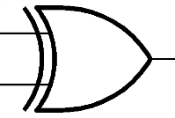
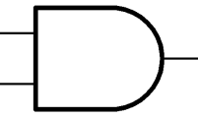
WHY does ADD AND MULTIPLY help?
XOR (add mod 2)
AND (mult mod 2)
0 XOR 0
0
0 AND 0
0
1 XOR 0
1
1 AND 0
0
0 XOR 1
1
0 AND 1
0
1 XOR 1
0
1 AND 1
1
Notes:
Fully Homomorphic Encryption – Encryption where you can compute both sums and products
Bits / numbers – for now, bits
(Enc(a), Enc(b) -> Enc(a XOR b) and Enc(a AND b))
{AND, XOR} is Turing-complete

Slide 51
WHY does ADD AND MULTIPLY help?
… because {XOR,AND} is Turing-complete …
(any function can be written as a combination of XOR and AND gates)
XOR (add mod 2)
AND (mult mod 2)
0 XOR 0
0
0 AND 0
0
1 XOR 0
1
1 AND 0
0
0 XOR 1
1
0 AND 1
0
1 XOR 1
0
1 AND 1
1
Notes:
Fully Homomorphic Encryption – Encryption where you can compute both sums and products
Bits / numbers – for now, bits
(Enc(a), Enc(b) -> Enc(a XOR b) and Enc(a AND b))
{AND, XOR} is Turing-complete

Slide 52
WHY does ADD AND MULTIPLY help?
… because {XOR,AND} is Turing-complete …
(any function can be written as a combination of XOR and AND gates)
Example: Searching a database
DB
index
I = i₁i₀
0
1
1
answer= DB_{I}
0
Notes:
Fully Homomorphic Encryption – Encryption where you can compute both sums and products
Bits / numbers – for now, bits
(Enc(a), Enc(b) -> Enc(a XOR b) and Enc(a AND b))
{AND, XOR} is Turing-complete

Slide 53
WHY does ADD AND MULTIPLY help?
… because {XOR,AND} is Turing-complete …
(any function can be written as a combination of XOR and AND gates)
i₀
i₁
Example: Searching a database
DB
index
I = i₁i₀
0
1
1
answer= DB_{I}
DB₃
DB₂
DB₀
DB₁
0
Notes:
Fully Homomorphic Encryption – Encryption where you can compute both sums and products
Bits / numbers – for now, bits
(Enc(a), Enc(b) -> Enc(a XOR b) and Enc(a AND b))
{AND, XOR} is Turing-complete

Slide 54
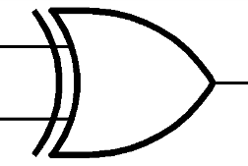
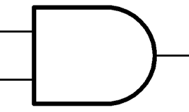
WHY does ADD AND MULTIPLY help?
… because {XOR,AND} is Turing-complete …
… if you can compute XOR and AND on encrypted bits…
… you can compute ANY function on encrypted inputs…
E(x₁)
E(x₂)
E(x₃)
E(x₄)
E(x₁ XOR x₂)
E(x₃ AND x₄)
E(f(x₁,x₂,x₃,x₄))
Notes:
Fully Homomorphic Encryption – Encryption where you can compute both sums and products
Bits / numbers – for now, bits
(Enc(a), Enc(b) -> Enc(a XOR b) and Enc(a AND b))
{AND, XOR} is Turing-complete

Slide 55
Private Search
This is A M A Z I N G!
Private Cloud computing
Notes:
Holy grail of cryptography

Slide 56
Private Search
This is A M A Z I N G!
Private Cloud computing
In general,
Delegate processing of data
without giving away access to it
Notes:
Splatter the screen with images – search, encrypted spam filter, encrypted adwords, private facebook, …
Holy grail of cryptography

Slide 57
People tried to compute both AND and XOR on encrypted bits …
… for years …
… and years …
… with no success.

Slide 58
Well, actually, there were some partial answers …
Fully homomorphic
Josh’s
system
MANY add
ZERO mult
MANY add
MANY mult

Slide 59
Well, actually, there were some partial answers …
Fully homomorphic
Josh’s
system
Boneh,Goh & Nissim
MANY add
ZERO mult
MANY add
1 mult
MANY add
MANY mult

Slide 60
… and some bold attempts [Fellows-Koblitz] …
… which were quickly broken …
Fully homomorphic
Josh’s
system
Boneh,Goh & Nissim
MANY add
ZERO mult
MANY add
1 mult
MANY add
MANY mult

Slide 61
… until, in October 2008 …
Notes:
Timeline – add, already gives voting, …. Quadratic formulas, gives more efficient PIR …. That’s where we were stuck….
Gallant attempts – Fellows and Koblitz
(People believed this was impossible. … )
Show all kinds of newspaper clips.. Ref Gentry… also refer to later works.
What it is –
And what it is not – but we are getting there.

Slide 62
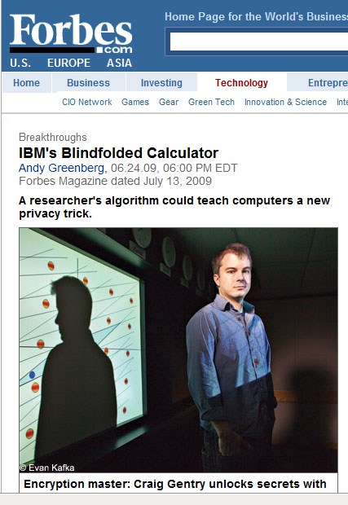
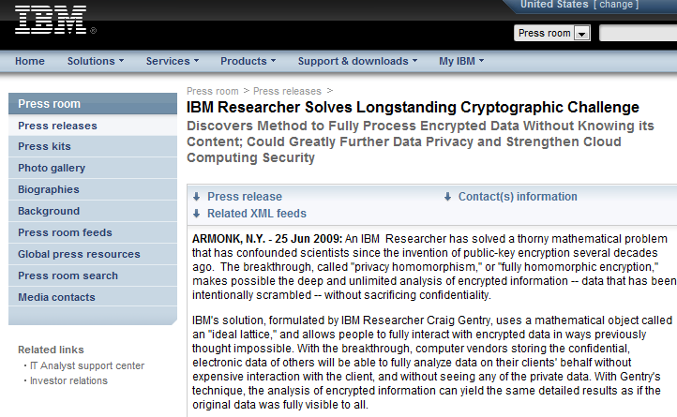
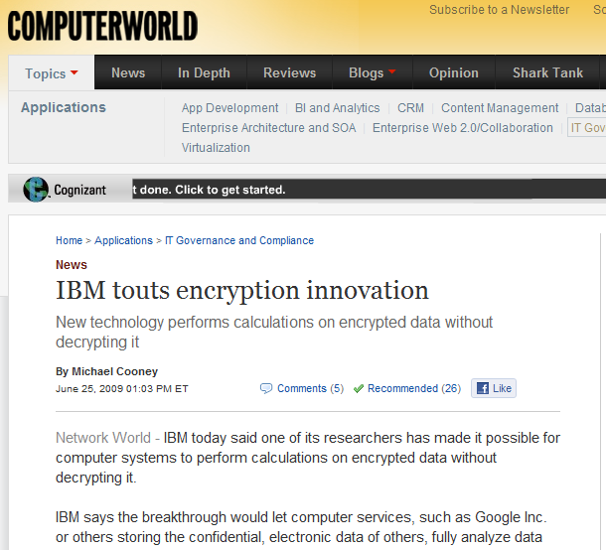
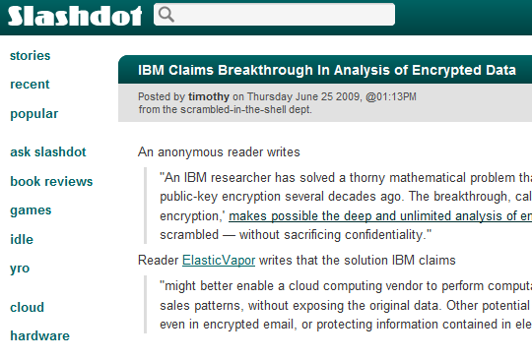
… until, in October 2008 …
… Craig Gentry came up with the first
fully homomorphic encryption scheme …
Notes:
Timeline – add, already gives voting, …. Quadratic formulas, gives more efficient PIR …. That’s where we were stuck….
Gallant attempts – Fellows and Koblitz
(People believed this was impossible. … )
Show all kinds of newspaper clips.. Ref Gentry… also refer to later works.
What it is –
And what it is not – but we are getting there.

Slide 63
How does it work?
What is the magic?
Notes:
Timeline – add, already gives voting, …. Quadratic formulas, gives more efficient PIR …. That’s where we were stuck….
Gallant attempts – Fellows and Koblitz
(People believed this was impossible. … )
Show all kinds of newspaper clips.. Ref Gentry… also refer to later works.
What it is –
And what it is not – but we are getting there.

Slide 64
Gentry’s scheme was complex …
… it used advanced algebraic number theory …
Notes:
What is the simplest object that we can both add and mult?

Slide 65
Some of us asked: can we make this really simple? …
Notes:
What is the simplest object that we can both add and mult?

Slide 66
Some of us asked: can we make this really simple? …
Polynomials?
$(x^{2}+6x+1)$ + $\left(x^{2}−6x\right)=({2x}^{2}+1)$
$(x^{2}+6x+1)$ X $\left(x^{2}−6x\right)=({x^{4}−35x}^{2}−6x)$
Notes:
What is the simplest object that we can both add and mult?

Slide 67
Some of us asked: can we make this really simple? …
Polynomials?
$(x^{2}+6x+1)$ + $\left(x^{2}−6x\right)=({2x}^{2}+1)$
$(x^{2}+6x+1)$ X $\left(x^{2}−6x\right)=({x^{4}−35x}^{2}−6x)$
Matrices?
$\left(\begin{matrix}1 & 0 \\ 1 & 2\end{matrix}\right) + \left(\begin{matrix}−1 & 1 \\ 0 & 1\end{matrix}\right)$ = $\left(\begin{matrix}0 & 1 \\ 1 & 3\end{matrix}\right)$
$\left(\begin{matrix}1 & 0 \\ 1 & 2\end{matrix}\right) X \left(\begin{matrix}−1 & 1 \\ 0 & 1\end{matrix}\right)$ = $\left(\begin{matrix}−1 & 1 \\ −1 & 3\end{matrix}\right)$
Notes:
What is the simplest object that we can both add and mult?

Slide 68
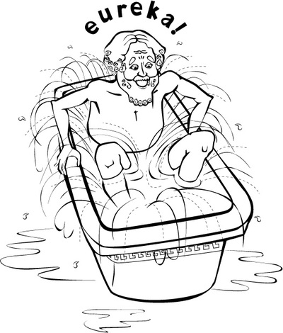
Some of us asked: can we make this really simple? …
Polynomials?
$(x^{2}+6x+1)$ + $\left(x^{2}−6x\right)=({2x}^{2}+1)$
$(x^{2}+6x+1)$ X $\left(x^{2}−6x\right)=({x^{4}−35x}^{2}−6x)$
Matrices?
$\left(\begin{matrix}1 & 0 \\ 1 & 2\end{matrix}\right) + \left(\begin{matrix}−1 & 1 \\ 0 & 1\end{matrix}\right)$ = $\left(\begin{matrix}0 & 1 \\ 1 & 3\end{matrix}\right)$
$\left(\begin{matrix}1 & 0 \\ 1 & 2\end{matrix}\right) X \left(\begin{matrix}−1 & 1 \\ 0 & 1\end{matrix}\right)$ = $\left(\begin{matrix}−1 & 1 \\ −1 & 3\end{matrix}\right)$
How about integers?!?
[Gentry, Halevi, van Dijk, V.]
$2$ + 3$=5$
$2$ X 3$=6$
Notes:
What is the simplest object that we can both add and mult?

Slide 69
TODAY: Secret-key (Symmetric-key) Encryption
Notes:
Noticed the structure: ordinary numbers can both be added and multiplied –
Encrypt m as p*q­₁ + m₁
Decrypt by doing (mod p)
Why is this secure at all?!

Slide 70
Secret key: large odd number p
-3p
-2p
-p
0
p
2p
3p
Notes:
Noticed the structure: ordinary numbers can both be added and multiplied –
Encrypt m as p*q­₁ + m₁
Decrypt by doing (mod p)
Why is this secure at all?!

Slide 71
Secret key: large odd number p
To Encrypt a bit b:
pick a (random) “large” multiple of p, say q·p
-3p
-2p
-p
0
p
2p
3p
Notes:
Noticed the structure: ordinary numbers can both be added and multiplied –
Encrypt m as p*q­₁ + m₁
Decrypt by doing (mod p)
Why is this secure at all?!

Slide 72
Secret key: large odd number p
To Encrypt a bit b:
pick a (random) “large” multiple of p, say q·p
pick a (random) “small” number 2·r+b
(this is even if b=0, and odd if b=1)
the “noise” = 2·r+b
-3p
-2p
-p
0
p
2p
3p
Notes:
Noticed the structure: ordinary numbers can both be added and multiplied –
Encrypt m as p*q­₁ + m₁
Decrypt by doing (mod p)
Why is this secure at all?!

Slide 73
Secret key: large odd number p
To Encrypt a bit b:
pick a (random) “large” multiple of p, say q·p
pick a (random) “small” number 2·r+b
(this is even if b=0, and odd if b=1)
Ciphertext c = q·p+2·r+b
the “noise” = 2·r+b
-3p
-2p
-p
0
p
2p
3p
Notes:
Noticed the structure: ordinary numbers can both be added and multiplied –
Encrypt m as p*q­₁ + m₁
Decrypt by doing (mod p)
Why is this secure at all?!

Slide 74
Secret key: large odd number p
To Encrypt a bit b:
pick a (random) “large” multiple of p, say q·p
pick a (random) “small” number 2·r+b
(this is even if b=0, and odd if b=1)
Ciphertext c = q·p+2·r+b
To Decrypt a ciphertext c:
Taking c mod p recovers the noise
the “noise” = 2·r+b
-3p
-2p
-p
0
p
2p
3p
Notes:
Noticed the structure: ordinary numbers can both be added and multiplied –
Encrypt m as p*q­₁ + m₁
Decrypt by doing (mod p)
Why is this secure at all?!

Slide 75
How secure is this?
… if there were no noise (think r=0)
… and I give you two encryptions of 0 (q₁p & q₂p)
… then you can recover the secret key p
= GCD(q₁p, q₂p)
the “noise” = 2·r+b
-3p
-2p
-p
0
p
2p
3p
Notes:
Noticed the structure: ordinary numbers can both be added and multiplied –
Encrypt m as p*q­₁ + m₁
Decrypt by doing (mod p)
Why is this secure at all?!

Slide 76
How secure is this?
… but if there is noise
… the GCD attack doesn’t work
… and neither does any attack (we believe)
… this is called the approximate GCD assumption
the “noise” = 2·r+b
-3p
-2p
-p
0
p
2p
3p
Notes:
Noticed the structure: ordinary numbers can both be added and multiplied –
Encrypt m as p*q­₁ + m₁
Decrypt by doing (mod p)
Why is this secure at all?!

Slide 77
XORing two encrypted bits:
c₁ = q₁·p + (2·r₁ + b₁)
c₂ = q₂·p + (2·r₂ + b₂)
the “noise” = 2·r+b
-3p
-2p
-p
0
p
2p
3p
Notes:
Noticed the structure: ordinary numbers can both be added and multiplied –
Encrypt m as p*q­₁ + m₁
Decrypt by doing (mod p)
Why is this secure at all?!

Slide 78
XORing two encrypted bits:
c₁ = q₁·p + (2·r₁ + b₁)
c₂ = q₂·p + (2·r₂ + b₂)
c₁+c₂ = p·(q₁ + q₂) + 2·(r₁+r₂) + (b₁+b₂)
the “noise” = 2·r+b
-3p
-2p
-p
0
p
2p
3p
Notes:
Noticed the structure: ordinary numbers can both be added and multiplied –
Encrypt m as p*q­₁ + m₁
Decrypt by doing (mod p)
Why is this secure at all?!

Slide 79
XORing two encrypted bits:
c₁ = q₁·p + (2·r₁ + b₁)
c₂ = q₂·p + (2·r₂ + b₂)
c₁+c₂ = p·(q₁ + q₂) + 2·(r₁+r₂) + (b₁+b₂)
Odd if b₁=0, b₂=1 (or)
b₁=1, b₂=0
Even if b₁=0, b₂=0 (or)
b₁=1, b₂=1
the “noise” = 2·r+b
-3p
-2p
-p
0
p
2p
3p
Notes:
Noticed the structure: ordinary numbers can both be added and multiplied –
Encrypt m as p*q­₁ + m₁
Decrypt by doing (mod p)
Why is this secure at all?!

Slide 80
XORing two encrypted bits:
c₁ = q₁·p + (2·r₁ + b₁)
c₂ = q₂·p + (2·r₂ + b₂)
c₁+c₂ = p·(q₁ + q₂) + 2·(r₁+r₂) + (b₁+b₂)
lsb= b₁ XOR b₂
the “noise” = 2·r+b
-3p
-2p
-p
0
p
2p
3p
Notes:
Noticed the structure: ordinary numbers can both be added and multiplied –
Encrypt m as p*q­₁ + m₁
Decrypt by doing (mod p)
Why is this secure at all?!

Slide 81
ANDing two encrypted bits:
c₁ = q₁·p + (2·r₁ + b₁)
c₂ = q₂·p + (2·r₂ + b₂)
c₁c₂ = p·(c₂·q₁+c₁·q₂-q₁·q₂) + 2·(r₁r₂+r₁b₂+r₂b₁) + b₁b₂
the “noise” = 2·r+b
-3p
-2p
-p
0
p
2p
3p
Notes:
Noticed the structure: ordinary numbers can both be added and multiplied –
Encrypt m as p*q­₁ + m₁
Decrypt by doing (mod p)
Why is this secure at all?!

Slide 82
ANDing two encrypted bits:
c₁ = q₁·p + (2·r₁ + b₁)
c₂ = q₂·p + (2·r₂ + b₂)
c₁c₂ = p·(c₂·q₁+c₁·q₂-q₁·q₂) + 2·(r₁r₂+r₁b₂+r₂b₁) + b₁b₂
lsb= b₁ AND b₂
the “noise” = 2·r+b
-3p
-2p
-p
0
p
2p
3p
Notes:
Noticed the structure: ordinary numbers can both be added and multiplied –
Encrypt m as p*q­₁ + m₁
Decrypt by doing (mod p)
Why is this secure at all?!

Slide 83
the noise grows!
the “noise” = 2·r+b
-3p
-2p
-p
0
p
2p
3p
Notes:
Flashback: Euclid. Euclid’s algorithm for greatest common divisors
Approximate Greatest Common Divisors problem
Euclid’s algorithm fails. And we believe so does every other algorithm…

Slide 84
the noise grows!
c₁+c₂ = p·(q₁ + q₂) + 2·(r₁+r₂) + (b₁+b₂)
noise= 2 * (initial noise)
the “noise” = 2·r+b
-3p
-2p
-p
0
p
2p
3p
Notes:
Flashback: Euclid. Euclid’s algorithm for greatest common divisors
Approximate Greatest Common Divisors problem
Euclid’s algorithm fails. And we believe so does every other algorithm…

Slide 85
the noise grows!
c₁+c₂ = p·(q₁ + q₂) + 2·(r₁+r₂) + (b₁+b₂)
noise= 2 * (initial noise)
c₁c₂ = p·(c₂·q₁+c₁·q₂-q₁·q₂) + 2·(r₁r₂+r₁b₂+r₂b₁) + b₁b₂
noise = (initial noise)²
the “noise” = 2·r+b
-3p
-2p
-p
0
p
2p
3p
Notes:
Flashback: Euclid. Euclid’s algorithm for greatest common divisors
Approximate Greatest Common Divisors problem
Euclid’s algorithm fails. And we believe so does every other algorithm…

Slide 86
the noise grows!
… so what’s the problem?
noise=14
-51
-34
-17
0
17
20
34
51
Notes:
Flashback: Euclid. Euclid’s algorithm for greatest common divisors
Approximate Greatest Common Divisors problem
Euclid’s algorithm fails. And we believe so does every other algorithm…

Slide 87
the noise grows!
… so what’s the problem?
decryption wil recover noise’=3
noise=14
-51
-34
-17
0
17
20
34
51
Notes:
Flashback: Euclid. Euclid’s algorithm for greatest common divisors
Approximate Greatest Common Divisors problem
Euclid’s algorithm fails. And we believe so does every other algorithm…

Slide 88
the noise grows!
… so what’s the problem?
If the |noise| > p/2, then …
decryption will output an incorrect bit
decryption wil recover noise’=3
noise=14
-51
-34
-17
0
17
20
34
51
Notes:
Flashback: Euclid. Euclid’s algorithm for greatest common divisors
Approximate Greatest Common Divisors problem
Euclid’s algorithm fails. And we believe so does every other algorithm…

Slide 89
So, what did we accomplish?
… we can do lots of additions and
… some multiplications
(= a “somewhat homomorphic” encryption)
Notes:
Flashback: Euclid. Euclid’s algorithm for greatest common divisors
Approximate Greatest Common Divisors problem
Euclid’s algorithm fails. And we believe so does every other algorithm…

Slide 90
So, what did we accomplish?
… we can do lots of additions and
… some multiplications
(= a “somewhat homomorphic” encryption)
… enough to do many useful tasks, e.g., database search, spam filtering etc.
Notes:
Flashback: Euclid. Euclid’s algorithm for greatest common divisors
Approximate Greatest Common Divisors problem
Euclid’s algorithm fails. And we believe so does every other algorithm…

Slide 91
So, what did we accomplish?
… we can do lots of additions and
… some multiplications
(= a “somewhat homomorphic” encryption)
… enough to do many useful tasks, e.g., database search, spam filtering etc.
But I promised much more …
Notes:
Flashback: Euclid. Euclid’s algorithm for greatest common divisors
Approximate Greatest Common Divisors problem
Euclid’s algorithm fails. And we believe so does every other algorithm…

Slide 92
Josh’s
system
Boneh,Goh & Nissim
Fully homomorphic
MANY add
ZERO mult
MANY add
1 mult
WE ARE HERE!
MANY add
MANY mult
Notes:
How do you add and multiply?

Slide 93
Gentry’s “bootstrapping theorem” …
Josh’s
system
Boneh,Goh & Nissim
Fully homomorphic
MANY add
ZERO mult
MANY add
1 mult
WE ARE HERE!
MANY add
MANY mult
Notes:
How do you add and multiply?

Slide 94
Gentry’s “bootstrapping theorem” …
… If you can go a (large) part of the way,
then you can go all the way.
[bootstrapping]
Josh’s
system
Boneh,Goh & Nissim
Fully homomorphic
MANY add
ZERO mult
MANY add
1 mult
WE ARE HERE!
MANY add
MANY mult
Notes:
How do you add and multiply?

Slide 95
Gentry’s “bootstrapping theorem” …
… If you can go a (large) part of the way,
then you can go all the way.
[HOW? WE’LL SEE IN A BIT]
[bootstrapping]
Josh’s
system
Boneh,Goh & Nissim
Fully homomorphic
MANY add
ZERO mult
MANY add
1 mult
WE ARE HERE!
MANY add
MANY mult
Notes:
How do you add and multiply?

Slide 96
How efficient is all this?
… can I buy a homomorphic encryption software and start encrypting my data?
Notes:
HOW FAST IS IT: 3 min / bit

Slide 97
How efficient is all this?
… can I buy a homomorphic encryption software and start encrypting my data?
… well, not quite yet
Notes:
HOW FAST IS IT: 3 min / bit

Slide 98
How efficient is all this?
… can I buy a homomorphic encryption software and start encrypting my data?
… well, not quite yet
… encrypting a bit takes ~19s (!) with the current best implementation
Notes:
HOW FAST IS IT: 3 min / bit

Slide 99
How efficient is all this?
… can I buy a homomorphic encryption software and start encrypting my data?
… well, not quite yet
… encrypting a bit takes ~19s (!) with the current best implementation
… it takes 99 min to encrypt this sentence
Notes:
HOW FAST IS IT: 3 min / bit

Slide 100
How efficient is all this?
… can I buy a homomorphic encryption software and start encrypting my data?
… well, not quite yet
… encrypting a bit takes ~19s (!) with the current best implementation
… but we are improving rapidly…
Notes:
HOW FAST IS IT: 3 min / bit

Slide 101
… a number of new, more efficient schemes
… optimized implementation efforts
(in hardware and software)
… and a $20M DARPA project to fund all this

Slide 102
… a number of new, more efficient schemes
… optimized implementation efforts
(in hardware and software)
… and a $20M DARPA project to fund all this
So, watch out for new developments!

Slide 103
References:
[1] “Computing arbitrary functions of Encrypted Data”,
Craig Gentry, Communications of the ACM 53(3), 2010.
[2] “Fully Homomorphic Encryption from the Integers”,
Marten van Dijk, Craig Gentry, Shai Halevi, Vinod Vaikuntanathan http://eprint.iacr.org/2009/616, Eurocrypt 2010.
[3] “Implementing Gentry’s Fully Homomorphic Encryption”,
Craig Gentry and Shai Halevi
https://researcher.ibm.com/researcher/files/us-shaih/fhe-implementation.pdf, Eurocrypt 2011.

Slide 104
Gentry’s “bootstrapping method” …
… If you can go a (large) part of the way,
then you can go all the way…
noise=p/2
noise=0
Notes:
How do you add and multiply?

Slide 105
Gentry’s “bootstrapping method” …
… If you can go a (large) part of the way,
then you can go all the way…
noise=p/2
Problem: Add and Mult increase noise
(Add doubles, Mult squares the noise)
noise=0
Notes:
How do you add and multiply?

Slide 106
Gentry’s “bootstrapping method” …
… If you can go a (large) part of the way,
then you can go all the way…
noise=p/2
Problem: Add and Mult increase noise
(Add doubles, Mult squares the noise)
So, we want to do noise-reduction
noise=0
Notes:
How do you add and multiply?

Slide 107
Let’s think…
… What is the best noise-reduction procedure?
noise=p/2
noise=0
Notes:
How do you add and multiply?

Slide 108
Let’s think…
… What is the best noise-reduction procedure?
… something that kills all noise
noise=p/2
noise=0
Notes:
How do you add and multiply?

Slide 109
Let’s think…
… What is the best noise-reduction procedure?
… something that kills all noise
noise=p/2
… and recovers the message
noise=0
Notes:
How do you add and multiply?

Slide 110
Let’s think…
… What is the best noise-reduction procedure?
… something that kills all noise
noise=p/2
… and recovers the message
Decryption!
noise=0
Notes:
How do you add and multiply?

Slide 111
Let’s think…
… What is the best noise-reduction procedure?
… something that kills all noise
noise=p/2
… and recovers the message
Decryption!
b
Decrypt
noise=0
Ctxt = Enc(b)
Secret key
Notes:
How do you add and multiply?

Slide 112
Let’s think…
… What is the best noise-reduction procedure?
… something that kills all noise
noise=p/2
… and recovers the message
Decryption!
Fn. that acts on ciphertext
and eliminates noise
b
Decrypt
noise=0
Ctxt = Enc(b)
Secret key
Notes:
How do you add and multiply?

Slide 113
Let’s think…
… What is the best noise-reduction procedure?
… something that kills all noise
noise=p/2
… and recovers the message
But I can’t give the secret key out for free!
Decryption!
b
Decrypt
noise=0
Ctxt = Enc(b)
Secret key
Notes:
How do you add and multiply?

Slide 114
Let’s think…
… I want to reduce noise without letting you decrypt
noise=p/2
But I can’t give the secret key out for free!
b
Decrypt
noise=0
Ctxt = Enc(b)
Secret key
Notes:
How do you add and multiply?

Slide 115
KEY IDEA:
… I cannot release the secret key (lest everyone sees my data)
… but I can release Enc(secret key)
noise=p/2
b
Decrypt
noise=0
Ctxt = Enc(b)
Secret key
Notes:
How do you add and multiply?

Slide 116
KEY IDEA:
… I cannot release the secret key (lest everyone sees my data)
… but I can release Enc(secret key)
noise=p/2
… called “Circular Encryption”
b
Decrypt
noise=0
Ctxt = Enc(b)
Secret key
Notes:
How do you add and multiply?

Slide 117
KEY IDEA:
… I cannot release the secret key (lest everyone sees my data)
… but I can release Enc(secret key)
noise=p/2
… called “Circular Encryption”
b
Decrypt
noise=0
Ctxt = Enc(b)
Enc(Secret key)
Notes:
How do you add and multiply?

Slide 118
KEY IDEA:
… I cannot release the secret key (lest everyone sees my data)
… but I can release Enc(secret key)
noise=p/2
… Now, to reduce noise …
… Homomorphically evaluate the decryption ckt!!!
b
Decrypt
noise=0
Ctxt = Enc(b)
Enc(Secret key)
Notes:
How do you add and multiply?

Slide 119
KEY IDEA:
… I cannot release the secret key (lest everyone sees my data)
… but I can release Enc(secret key)
noise=p/2
… Now, to reduce noise …
… Homomorphically evaluate the decryption ckt!!!
Enc(b)
Decrypt
noise=0
Ctxt = Enc(b)
Enc(Secret key)
Notes:
How do you add and multiply?

Slide 120
KEY IDEA:
… I cannot release the secret key (lest everyone sees my data)
… but I can release Enc(secret key)
noise=p/2
… Now, to reduce noise …
… Homomorphically evaluate the decryption ckt!!!
Enc(b)
Decrypt
noise=0
Ctxt = Enc(b)
Enc(Secret key)
Notes:
How do you add and multiply?

Slide 121
KEY IDEA:
… I cannot release the secret key (lest everyone sees my data)
… but I can release Enc(secret key)
noise=p/2
KEY OBSERVATION:
… the input Enc(b) and output Enc(b) have
different noise levels …
Enc(b)
Decrypt
noise=0
Ctxt = Enc(b)
Enc(Secret key)
Notes:
How do you add and multiply?

Slide 122
KEY IDEA:
… I cannot release the secret key (lest everyone sees my data)
… but I can release Enc(secret key)
noise=p/2
KEY OBSERVATION:
Regardless of the noise in the input Enc(b)…
the noise level in the output Enc(b) is FIXED
Enc(b)
Decrypt
noise=0
Ctxt = Enc(b)
Enc(Secret key)
Notes:
How do you add and multiply?

Slide 123
KEY IDEA:
… I cannot release the secret key (lest everyone sees my data)
… but I can release Enc(secret key)
noise=p/2
KEY OBSERVATION:
Regardless of the noise in the input Enc(b)…
the noise level in the output Enc(b) is FIXED
Enc(b)
Decrypt
noise=0
Ctxt = Enc(b)
Enc(Secret key)
Notes:
How do you add and multiply?

Slide 124
KEY IDEA:
… I cannot release the secret key (lest everyone sees my data)
… but I can release Enc(secret key)
noise=p/2
KEY OBSERVATION:
Regardless of the noise in the input Enc(b)…
the noise level in the output Enc(b) is FIXED
Enc(b)
Decrypt
noise=0
Ctxt = Enc(b)
Enc(Secret key)
Notes:
How do you add and multiply?

Slide 125
KEY IDEA:
… I cannot release the secret key (lest everyone sees my data)
… but I can release Enc(secret key)
noise=p/2
KEY OBSERVATION:
Regardless of the noise in the input Enc(b)…
the noise level in the output Enc(b) is FIXED
Enc(b)
Decrypt
noise=0
Ctxt = Enc(b)
Enc(Secret key)
Notes:
How do you add and multiply?

Slide 126
Bottomline: whenever noise level increases
beyond a limit …
… use bootstrapping to reset it to a fixed level
noise=p/2
noise=0
Notes:
How do you add and multiply?

Slide 127
Bootstrapping requires homomorphically
evaluating the decryption circuit …
noise=p/2
noise=0
Notes:
How do you add and multiply?

Slide 128
Bootstrapping requires homomorphically
evaluating the decryption circuit …
noise=p/2
Thus,
Gentry’s “bootstrapping theorem”:
If an enc scheme can evaluate its own decryption circuit, then it can evaluate everything
noise=0
Notes:
How do you add and multiply?

